Slide 1
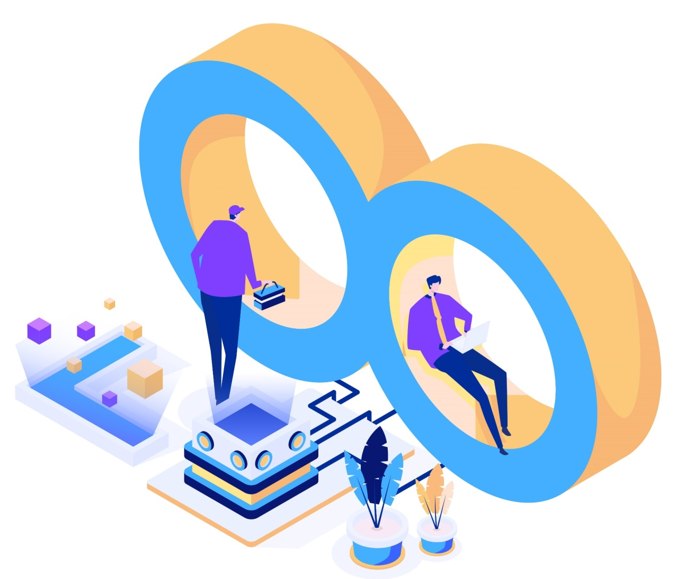
DevOps - The Infinite Loop
Introduction to 5W’s of DevOps

Slide 2



Contents
Introduction to DevOps
5 W’s of DevOps
Case Study

Slide 3
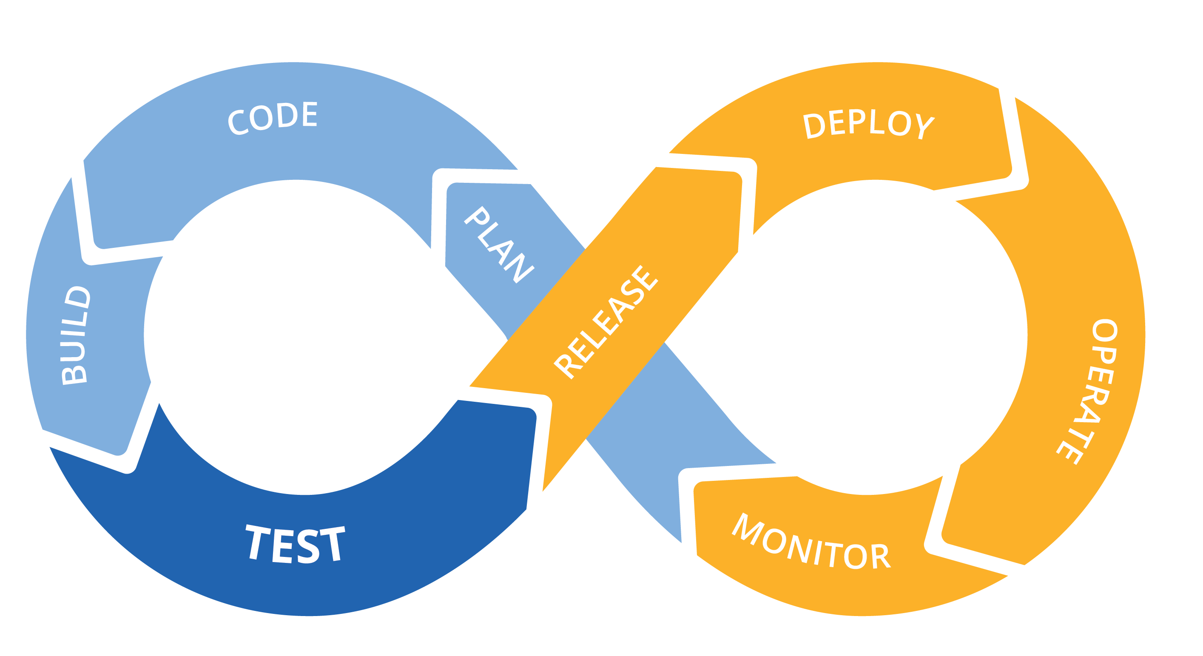
Introduction to DevOps
The idea behind DevOps is to demolish the wall between development and operations, and encourage more collaboration and accountability between both groups so that everyone feels responsible for the code no matter where it is in the software development lifecycle.
Tighter alignment between Development & Operations to increase application velocity with managed risk.

Slide 4

5W’s of DevOps
What is DevOps?
Why do we need DevOps?
When do we need DevOps?
For Whom do we need DevOps?
Where do we need DevOps?

Slide 5
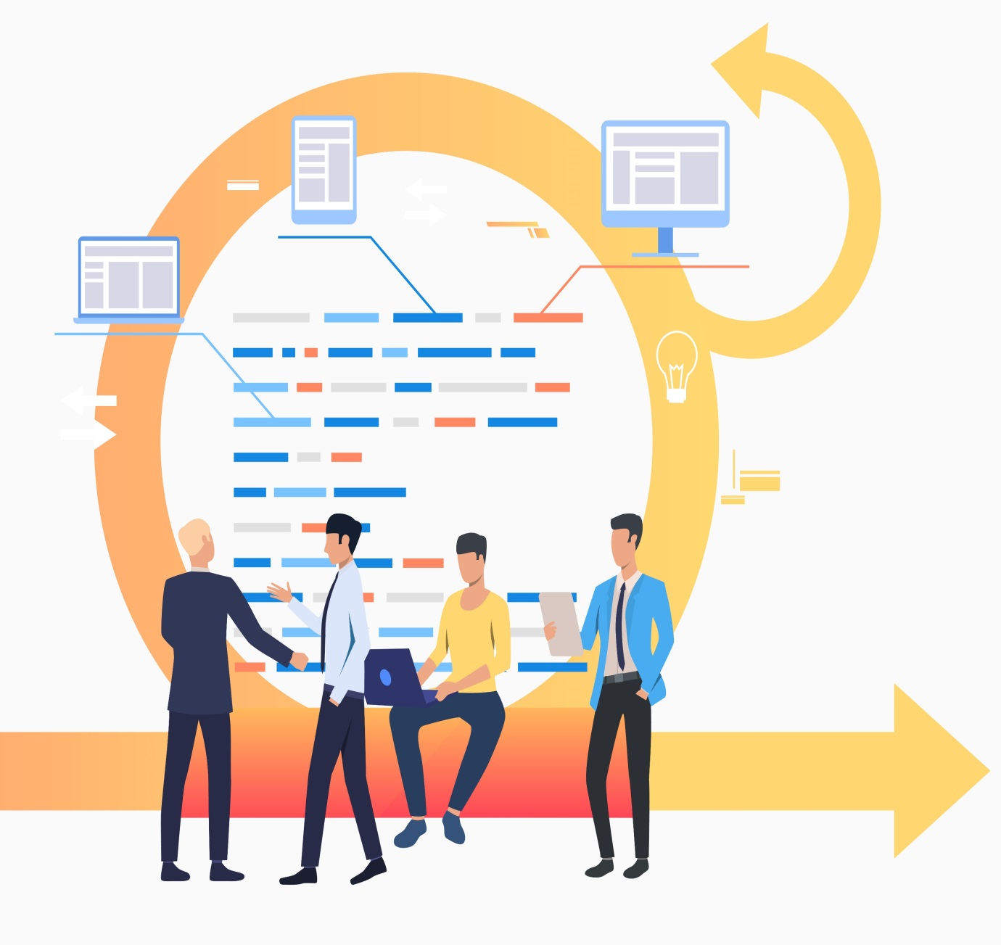
What is DevOps?
Method that emphasis communication, collaboration and integration between software developers operations professionals.
Environment that promotes cross practicality, shared business tasks and belief
Movement that improves IT service delivery agility
Culture that promotes better working relationship within the company.
Set of practices that provides rapid, reliable and predictable software delivery.

Slide 6
Why do we need DevOps?
The need for greater collaboration between development & operations team
The increasing use of mobile devices
The increasing need to develop or deploy cloud based applications
An increasingly complex IT infrastructure that is part physical, part virtualized and part cloud
A greater need for simultaneous deployment across different platforms
Pressures from the business to release apps more quickly to meet customer demand
Need to improve the end-to-end customer experience
47%
41%
41%
39%
35%
31%
28%
Base: Forrester research done with base 300 IT companies between June 2015 to May 2016

Slide 7

When do we need DevOps?
We need to release software / updates on-time.
We want to ensure stable release and environment, maximum times
We aim to address problems before the end users get impacted.
We want to have continuous incremental delivery.

